Slide 1
Property Sales :
Exploring Real Estate Trends
Group 6 Ankit Malhotra Qi An Chen Sahana Rajesh

Slide 2
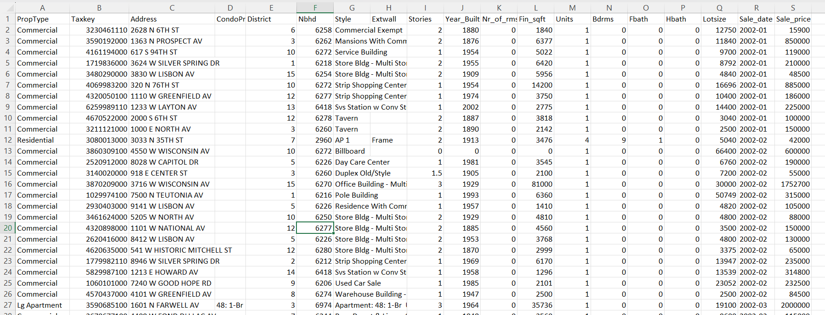
Data (20 Var in total, using 13 in total( please write this properly
1 2 3
PropType "Commercial" "residential" "Commercial"
Taxkey "3230461110" "3590192000" "4161194000"
Address "2628 N 6TH ST" "1363 N PROSPECT AV" "617 S 94TH ST"
District " 6" " 3" "10"
Nbhd "6258" "6262" "6272"
Style "Commercial Exempt" "Mansions With Commercial Usage" "Service Building"
Extwall "" "" ""
Stories "2" "2" "1"
Year_Built "1880" "1876" "1954"

Slide 3
What do we plan to do?
Tracking property sales and trying to predict sales of a property based on the given variables.
Try to understand a relation between time and how it has affected price in the past, and if we can predict the price in the future, based on time as well being a major factor.

Slide 4
Variables
Year built
Nbhd
Fbath
sales_price
Extwall
Style
Stories
Size and Rooms
Lotsize
Finished sqft
Bdrms

Slide 5
Data Sampling
data.new <- myData[sample(nrow(myData), size = 1000, replace = FALSE), ]
data.new

Slide 6
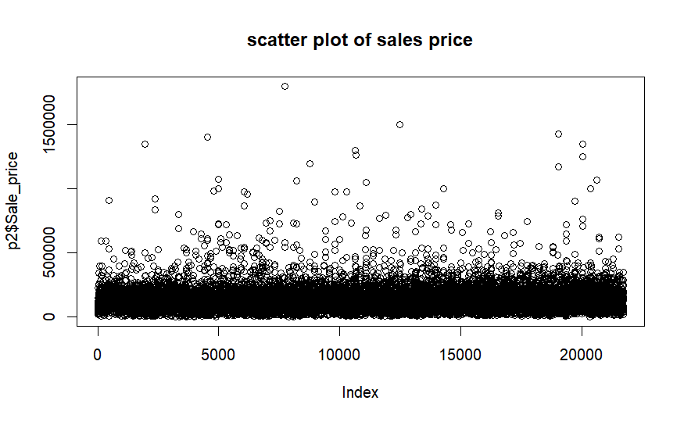
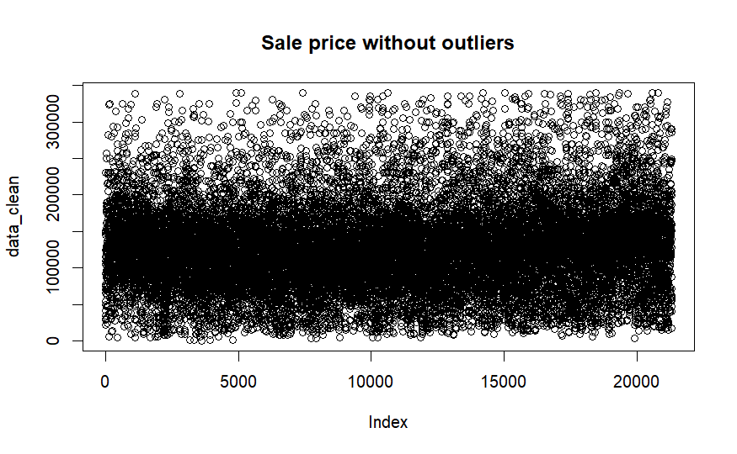
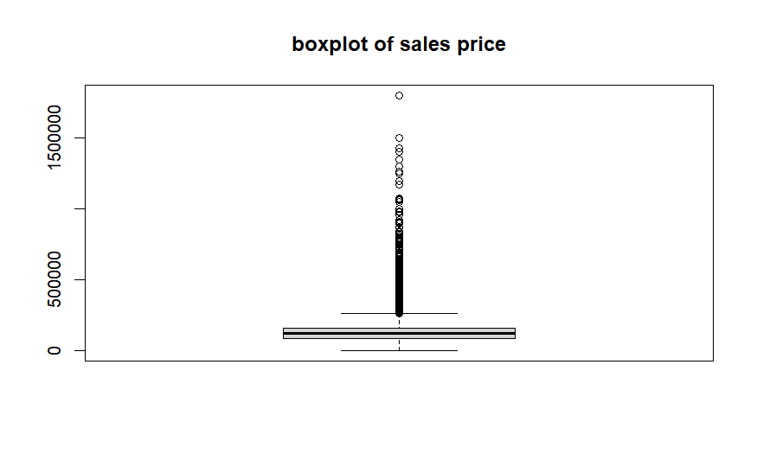
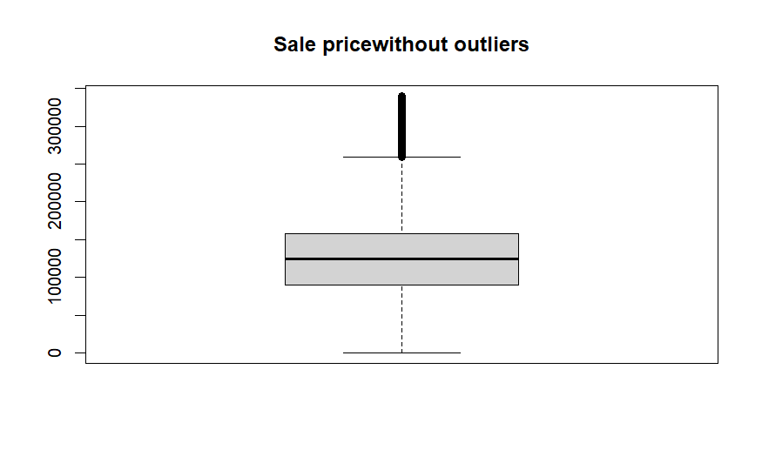
Sales_Price
Notes:
So you can go ahead and say that sales prices are in general all over the place, but in our data, we have sales prices having max density around 42,000$ to 250000$ ,some outliers but still significant

Slide 7
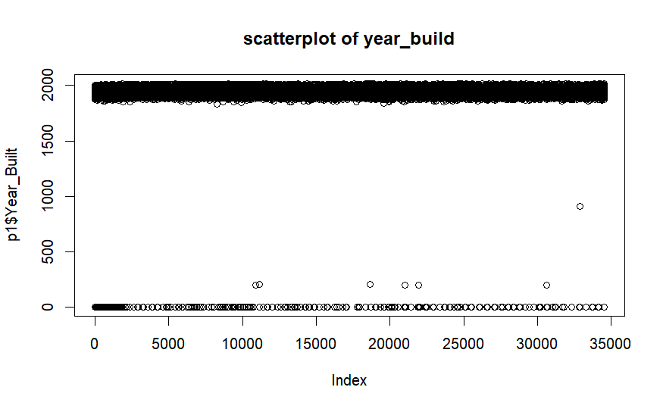
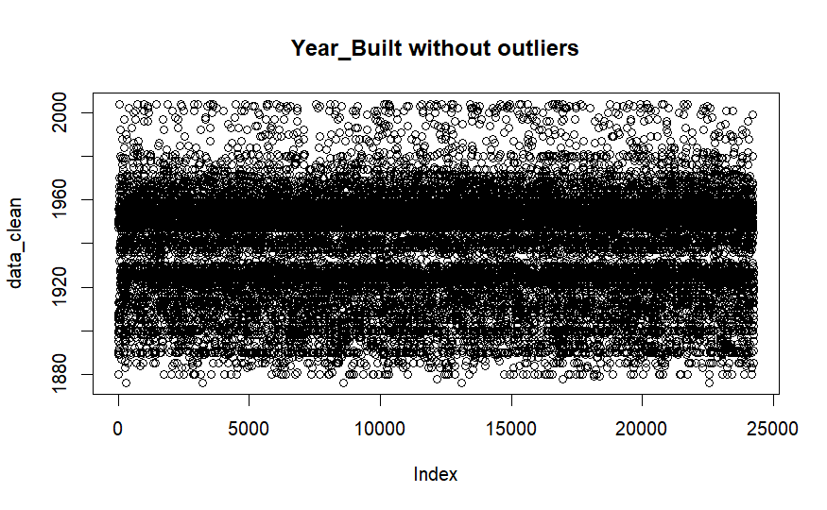
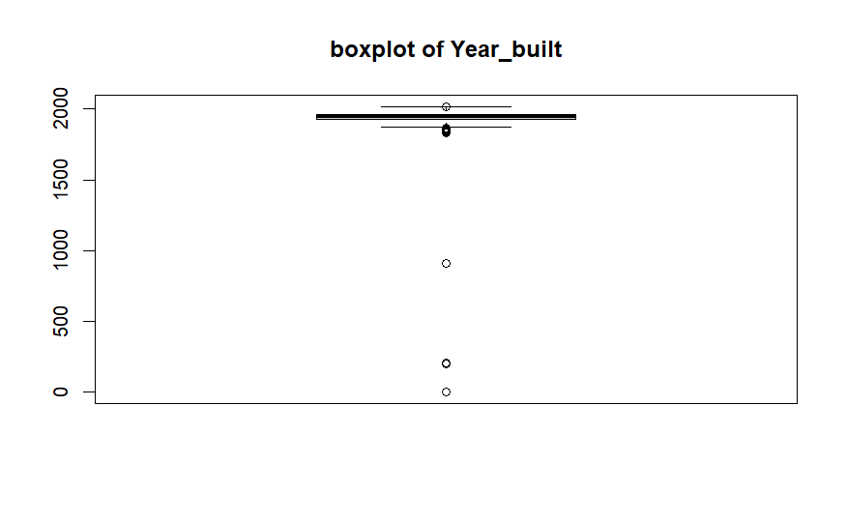
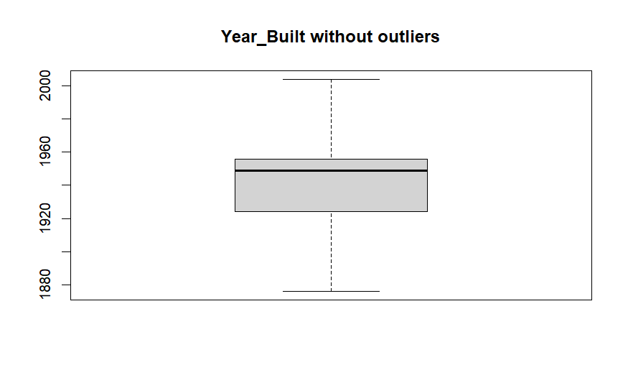
Year_built
Notes:
Should Remove outliers

Slide 8
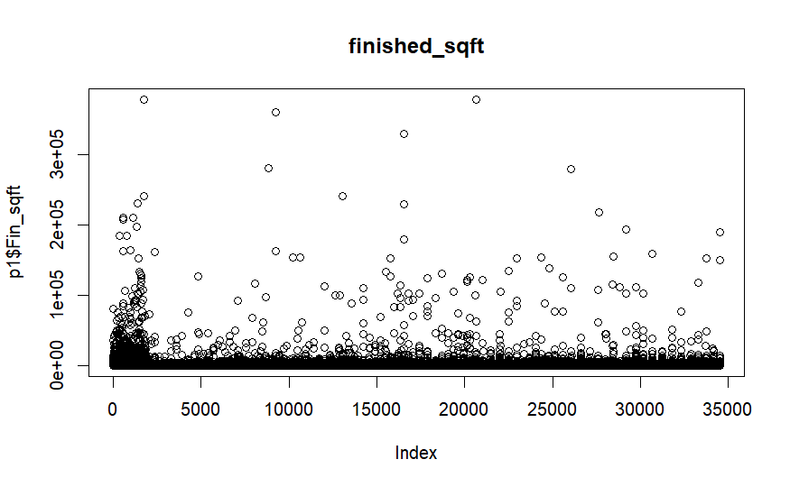
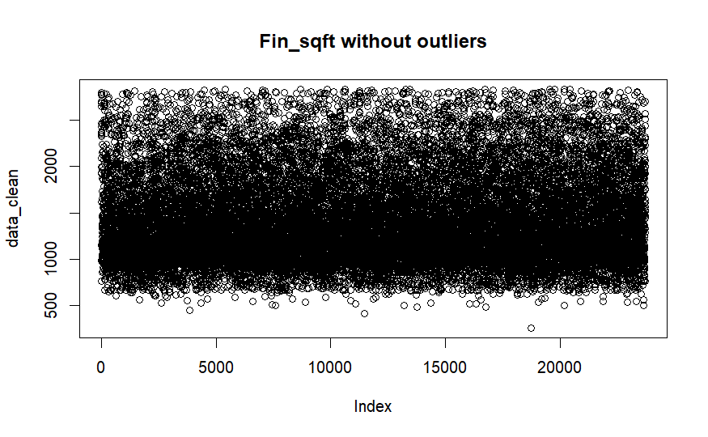
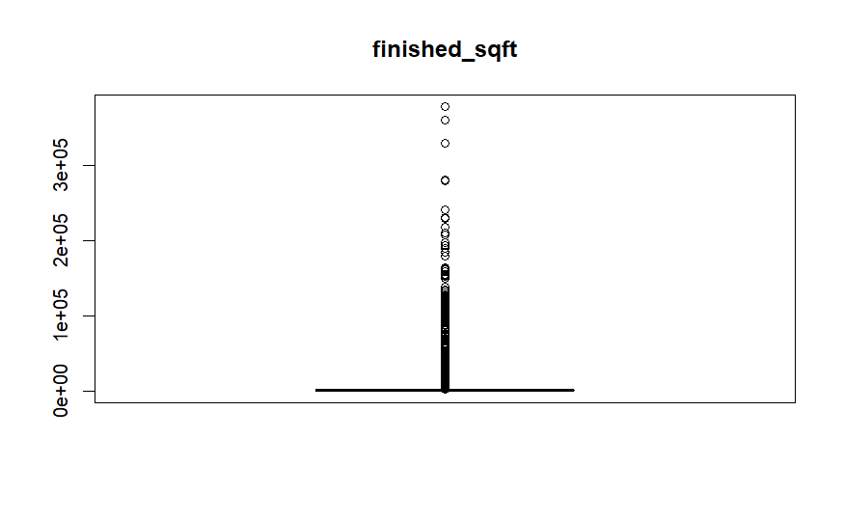
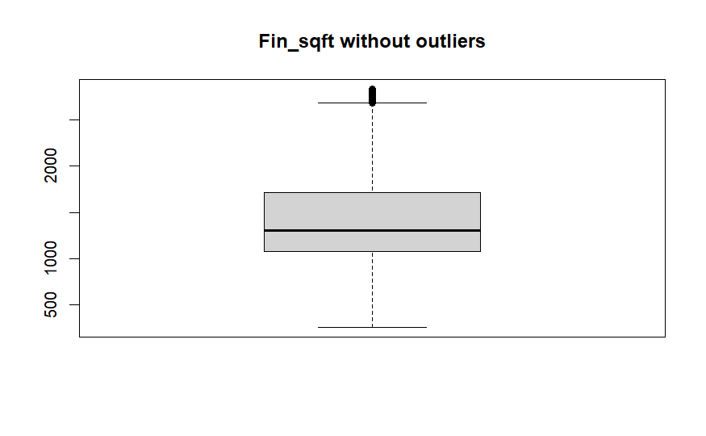
Finished_sqft
Notes:
So for here as well, you can say that the sqft has a few outliers, which we have taken care of, and we believe that sqft is our top 3 impacting variables

Slide 9
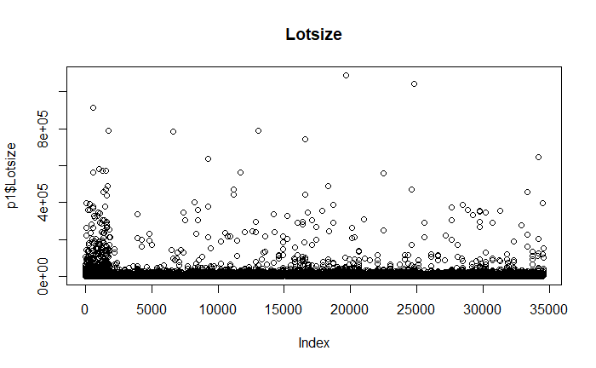
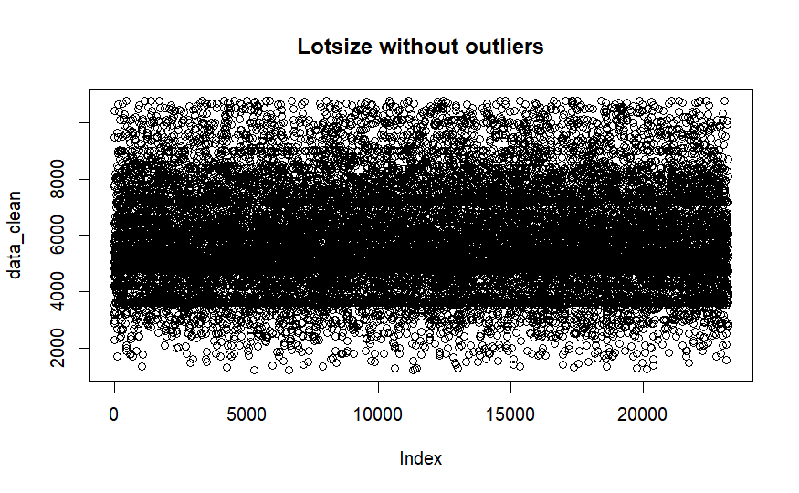
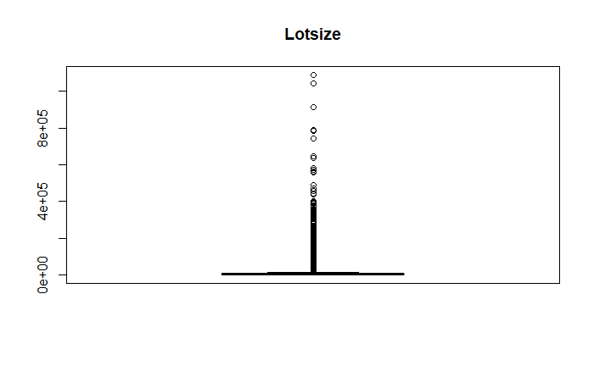
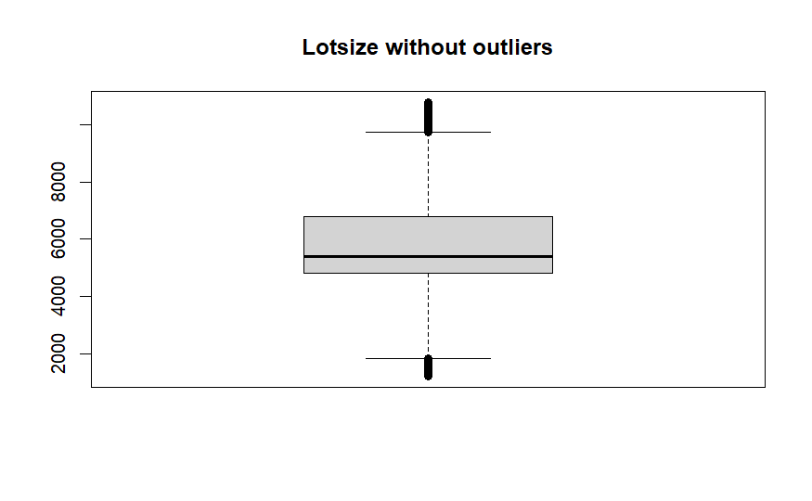
Lotsize

Slide 10
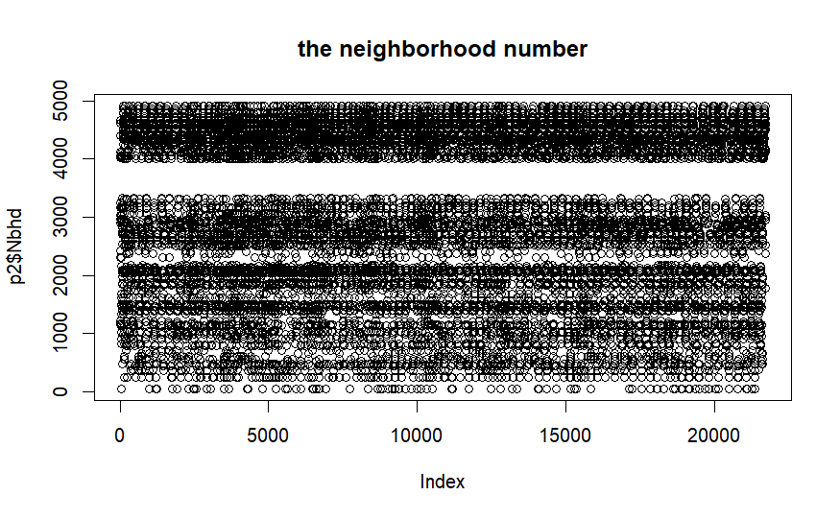
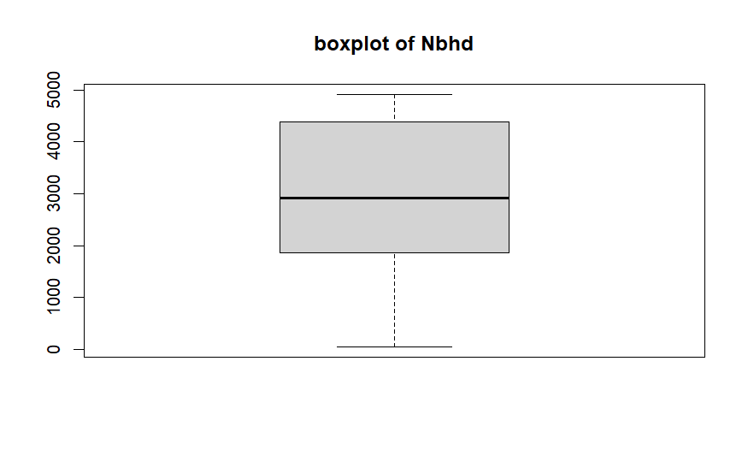
Nbhd

Slide 11
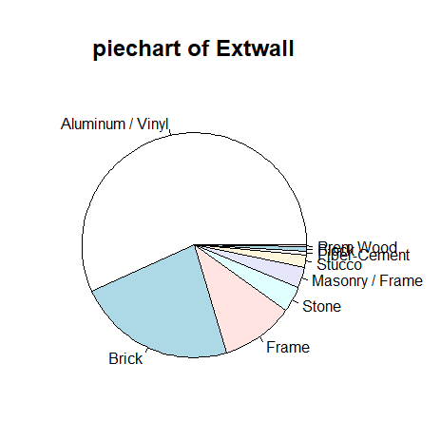
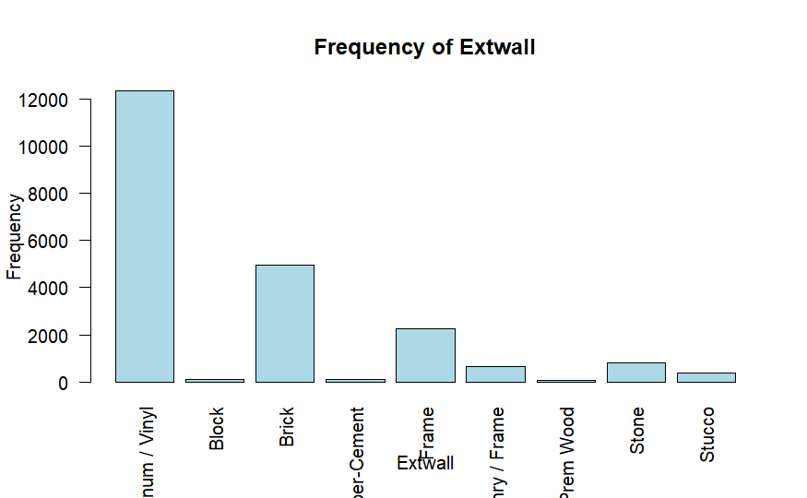
Extwall

Slide 12
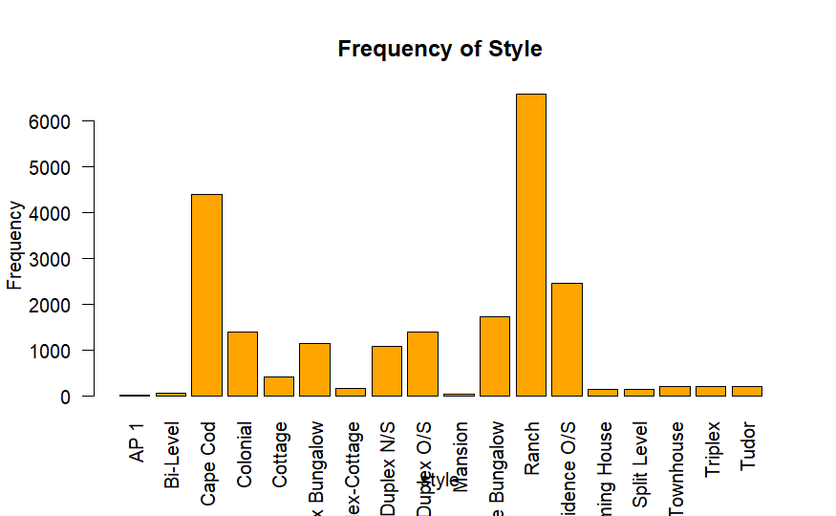
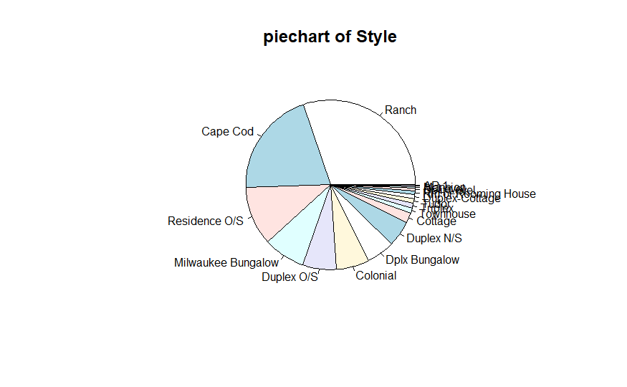
Style
Notes:
Is there

Slide 13
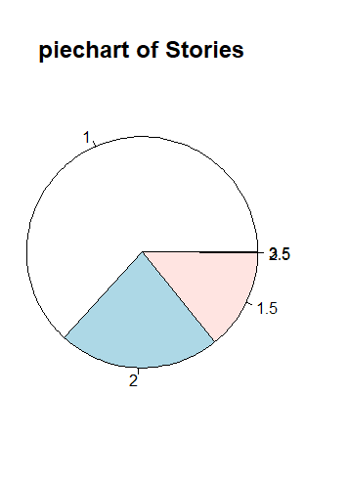
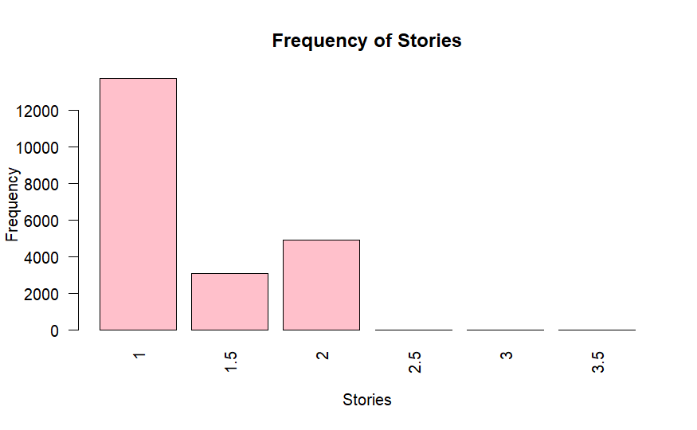
Stories
Notes:
We view it as a nominal variables
attic

Slide 14
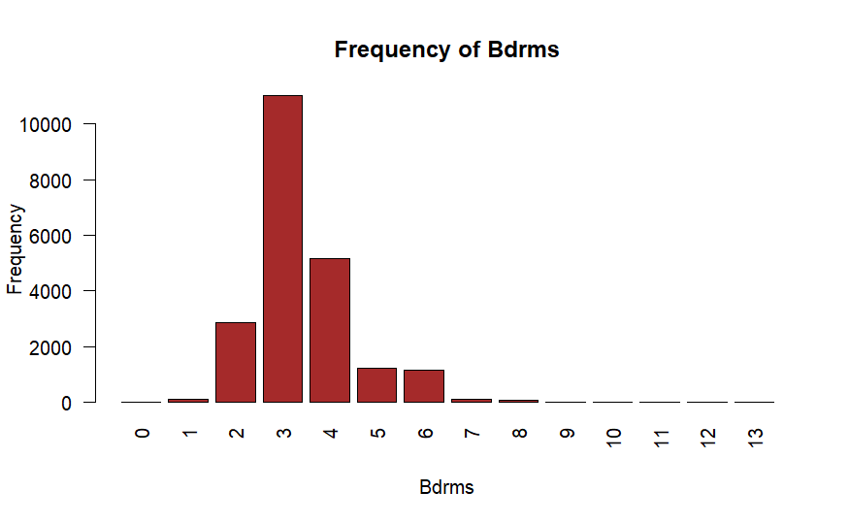
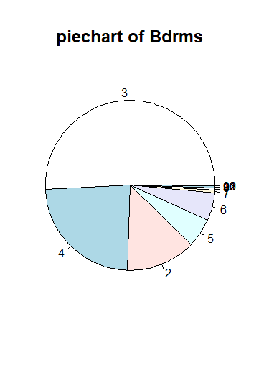
Bdrms

Slide 15
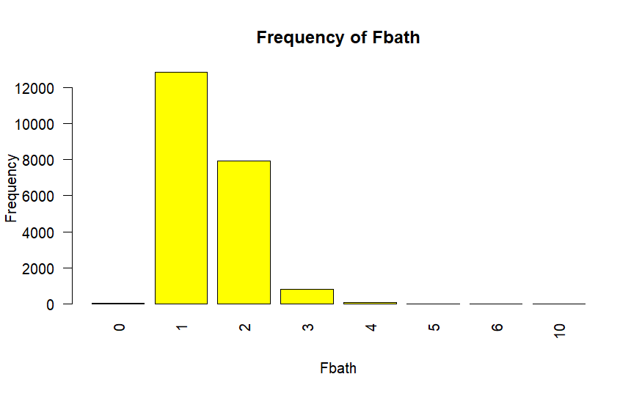
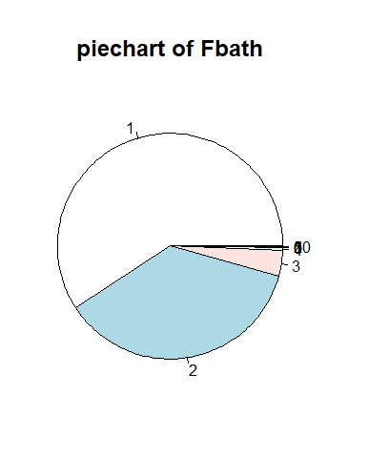
Fbath

Slide 16
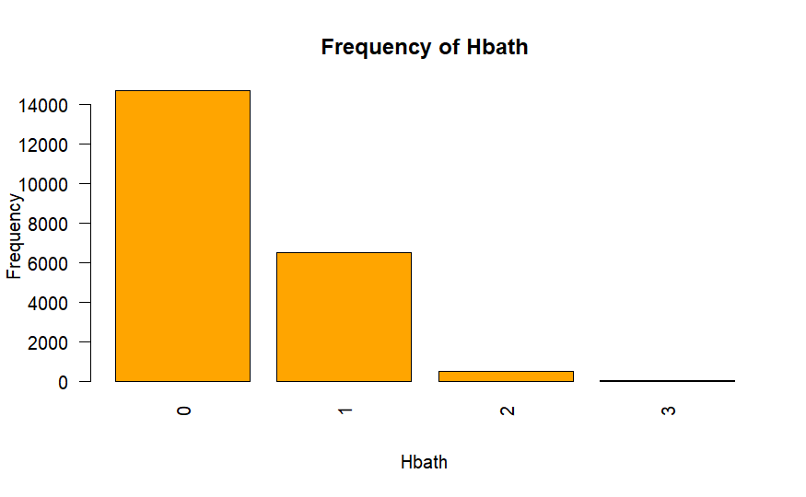
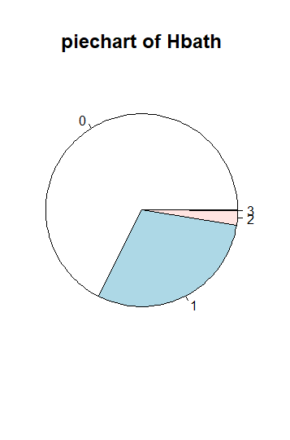
Hbath
Notes:
How could we upload the new PPT. I don’t think we can, but we will mail the professor and request him. I am sure he will listen

Slide 17
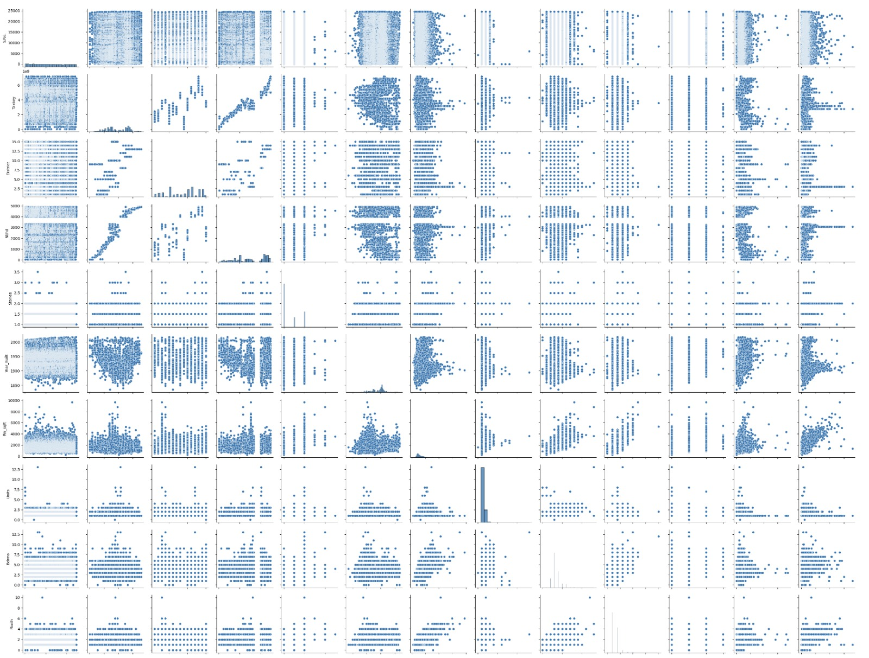
Why are we showing this?

Slide 18
Thank you! Questions?

